Slide 1


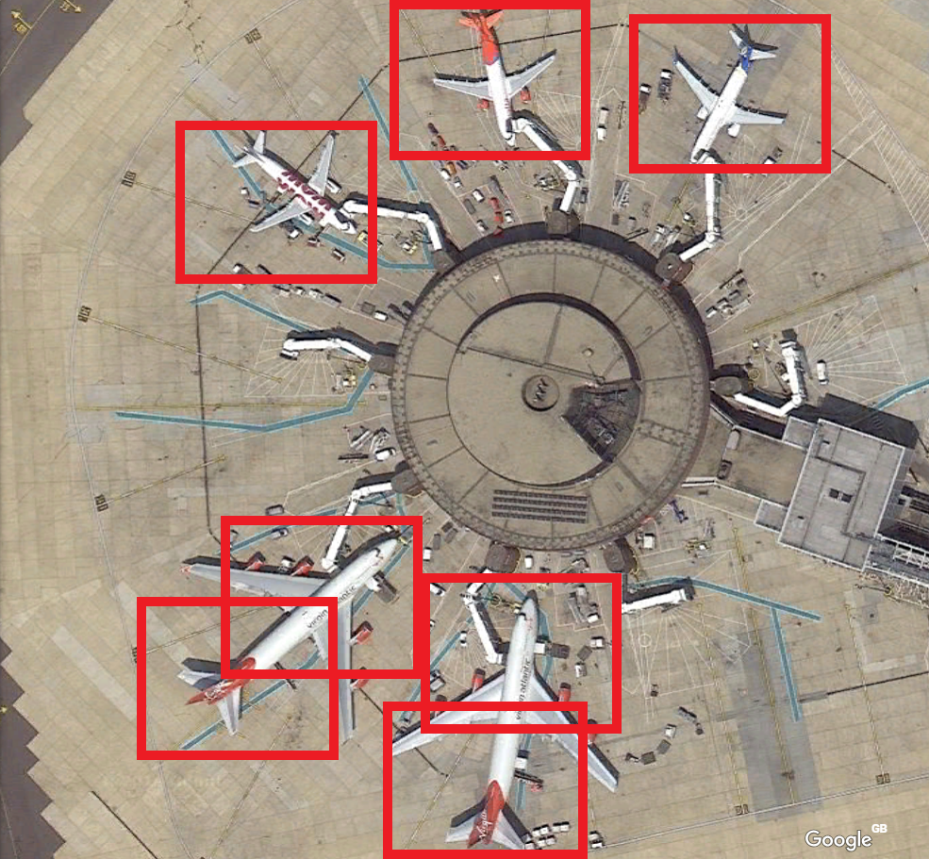
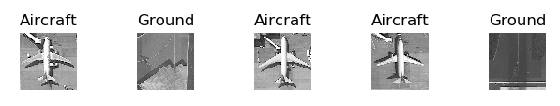
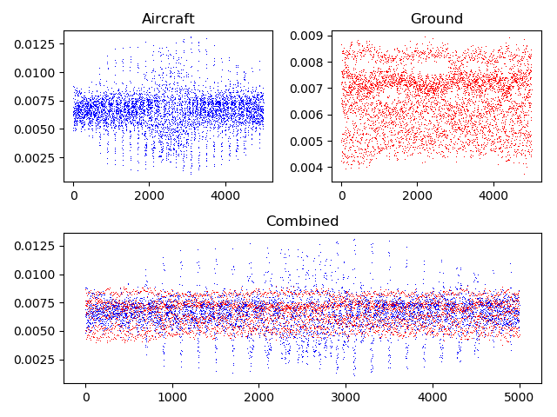
Identifying Aircraft from Above
Kai Roper-Blackman supervised by Sebastian Halder
We all know what an aircraft looks like, but does a computer? A seemingly simple task that can be carried out by individuals at age two, poses a complex problem to modern technology. Machine learning is a relatively new field with little research but many applications. The same techniques used to identify aircraft can be used in various software applications utilized in self-driving cars, face recognition systems and many others. The development of object recognition is the centre of many companies’ business models and objectives. To undertake this task, machine learning models are trained by providing existing images of aircraft and ground images. The model forms an understanding of the training data and makes predictions on test data with associated probabilities. The results obtained shows accuracy of 100% when identifying standalone aircraft filling the whole frame. However, when searching for aircraft in larger images, accuracy drastically decreases. To 50-60%. This demonstrates how new machine learning applications are. After optimization, the system used to identify aircraft can be applied to a myriad of identification problems.

